Slide 1
The Grenada Gateway
Gateway to the Grenadines, Caribbean, Americas & Europe

Slide 2
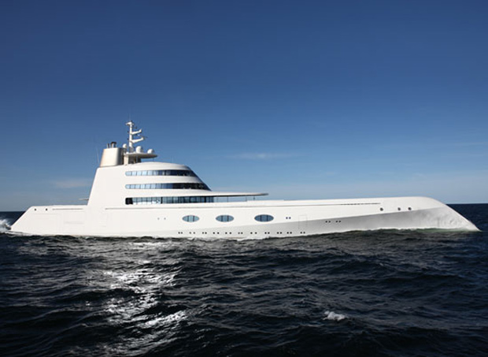


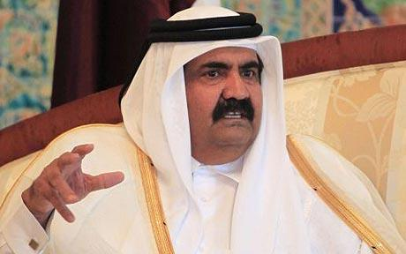
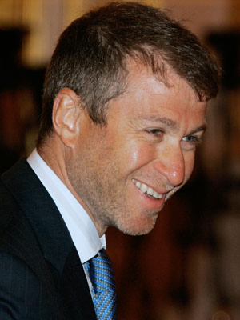
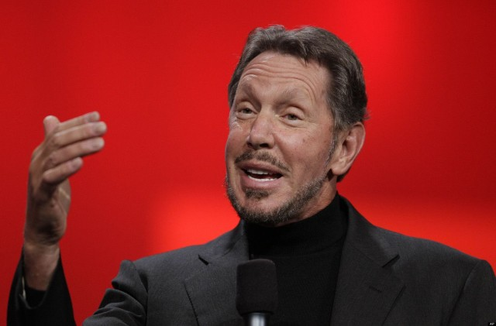
Global Business Leaders Love Grenada
Emir of Qatar
Bill Gates
Oprah Winfrey
Larry Ellison
Roman Abromovich
Andrey Melnichenko's

Slide 3
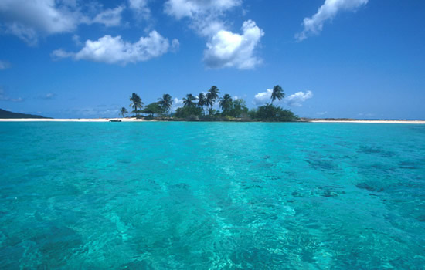
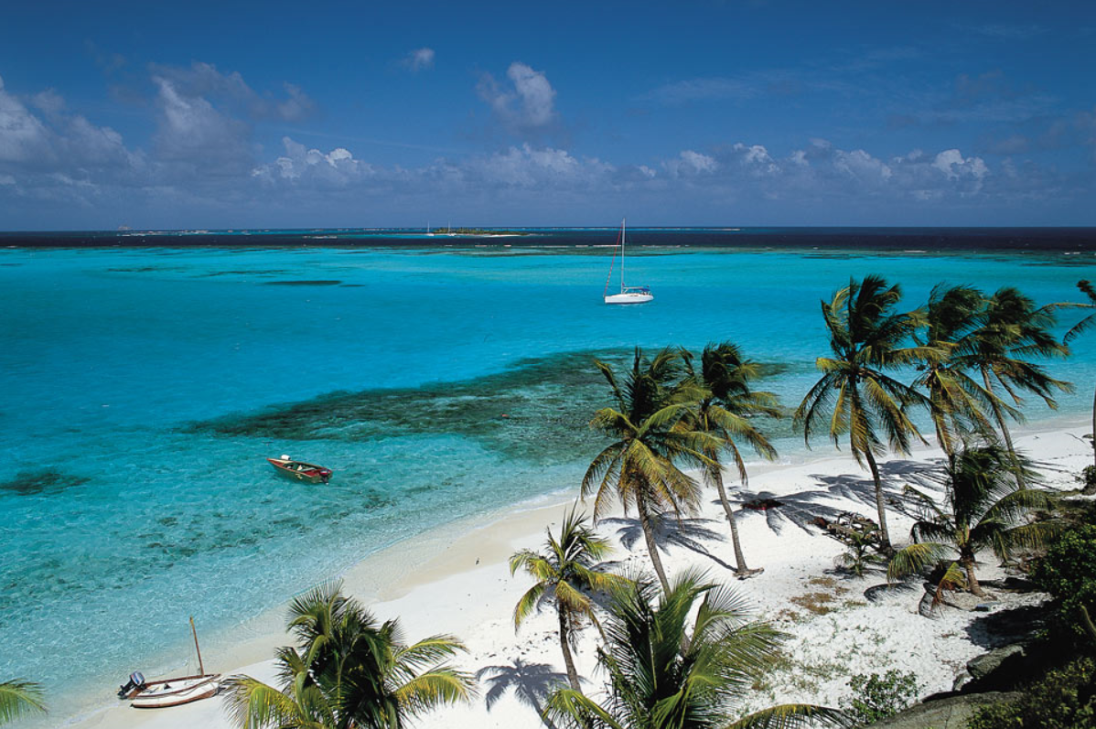
Grenada: Gateway to the Grenadines
Pristine Necklace of Islands from Grenada to St. Vincent

Slide 4
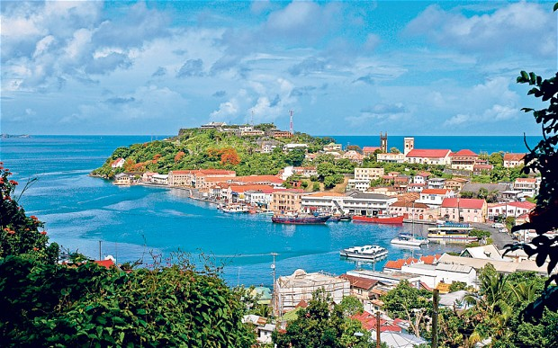
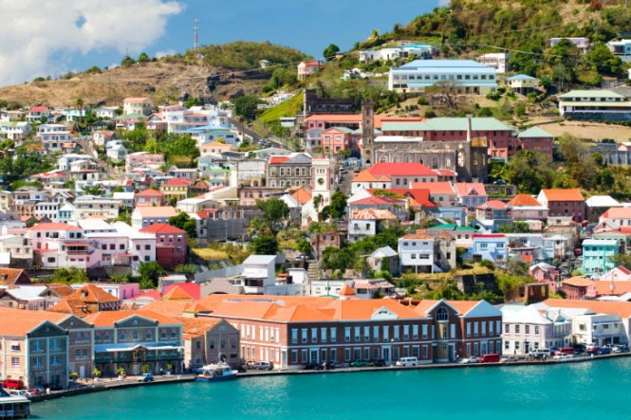
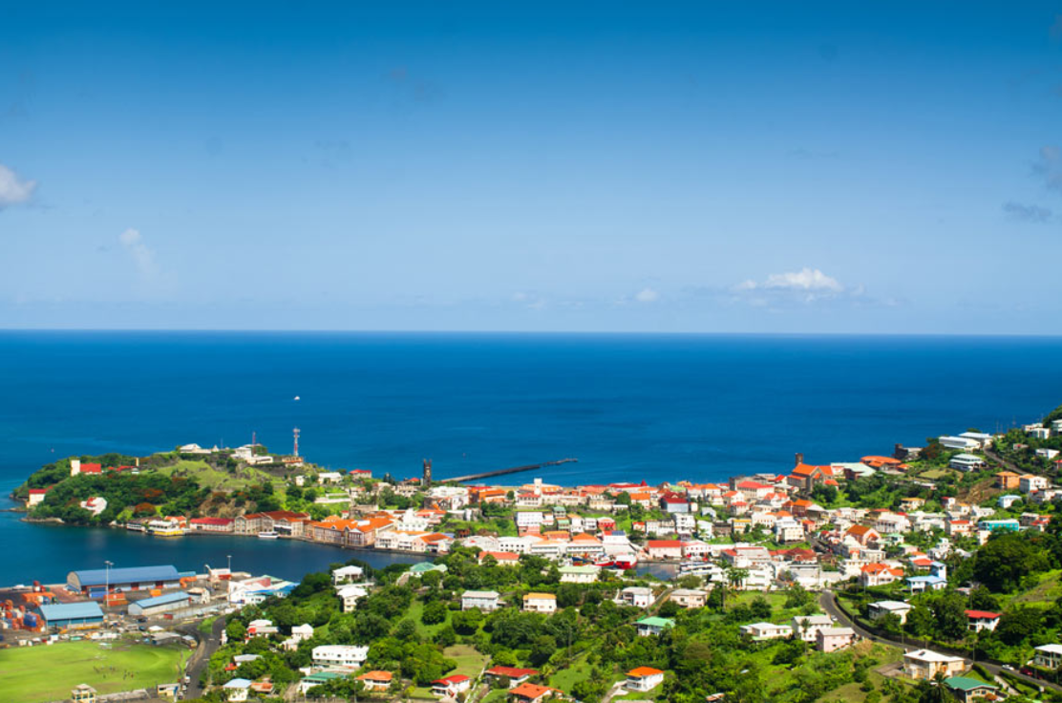
Grenada: Gateway to the Grenadines
Capital, St. George’s: “The prettiest harbor in the Caribbean”: Portofino / Italy. St. Tropez / France

Slide 5
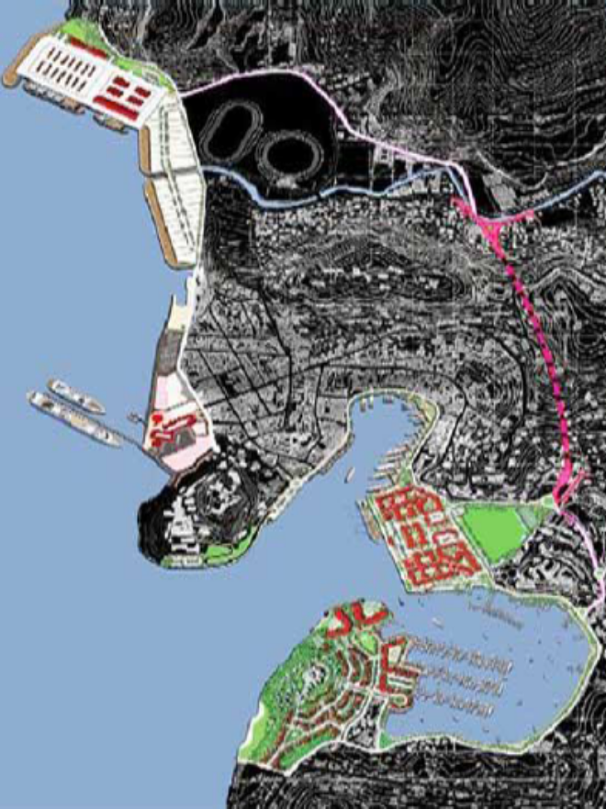
Grenada: Gateway Opportunities
Gateway to the Grenadines:
  Port for Super Yachts
Gateway to the Southern Caribbean:
  Regional Trade and Ferry Port
Gateway to The Americas & Europe:
  Citizenship by Investment

Slide 6
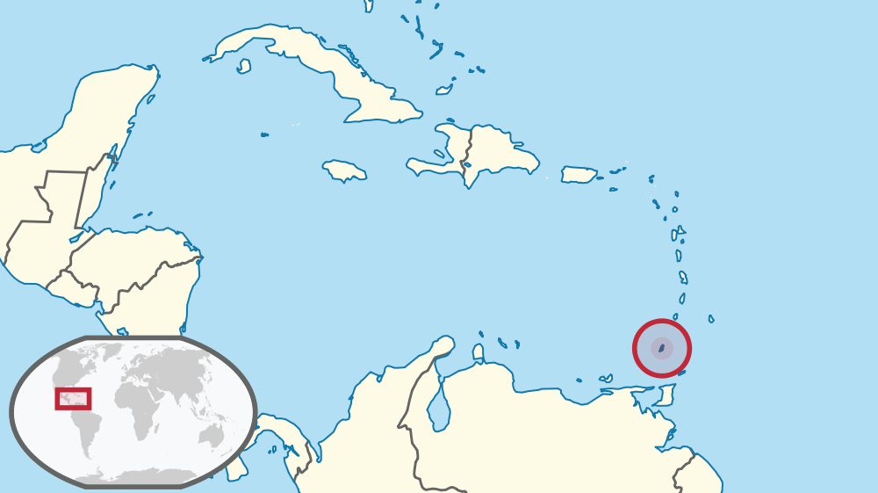

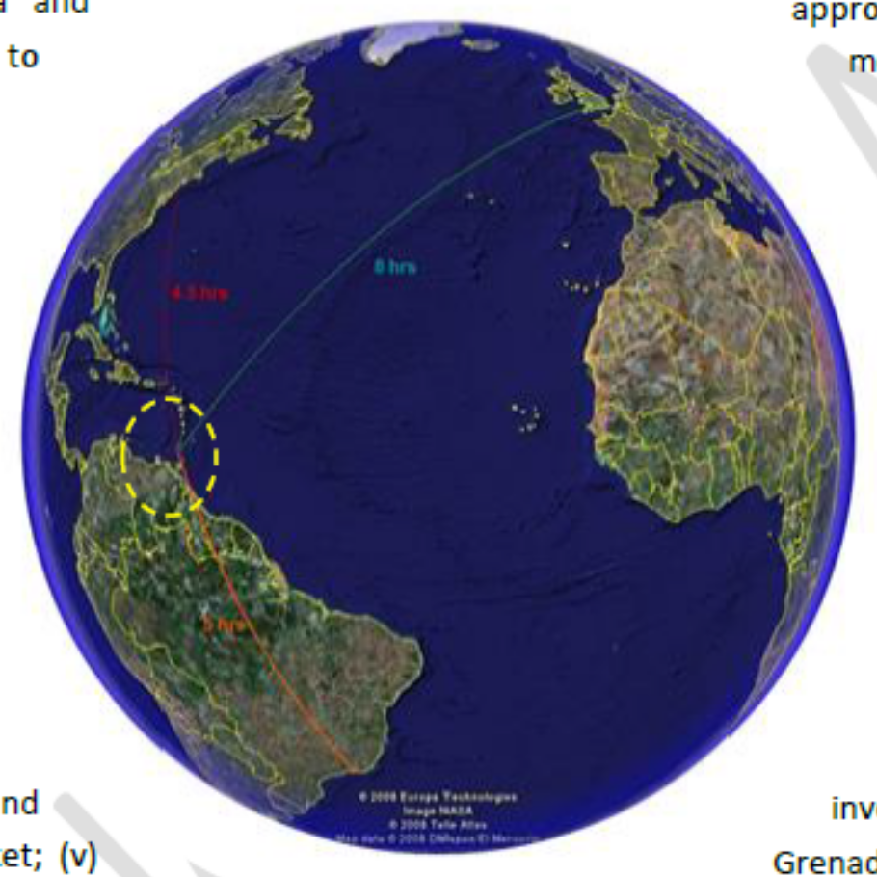



Grenada: Location
Gateway to the Grenadines:
  20 minutes
Gateway to the Southern Caribbean:
  35 minutes
Gateway to The Americas & Europe:
  5 hours to New York, 8 hours to London

Slide 7
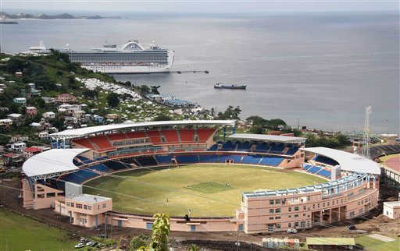
Grenada: The Country
Strong Ties with the Peoples Republic of China
Supports One China Policy
National Stadium from the PRC
Cricket World Cup 2007
Chinese Community in Grenada

Slide 8
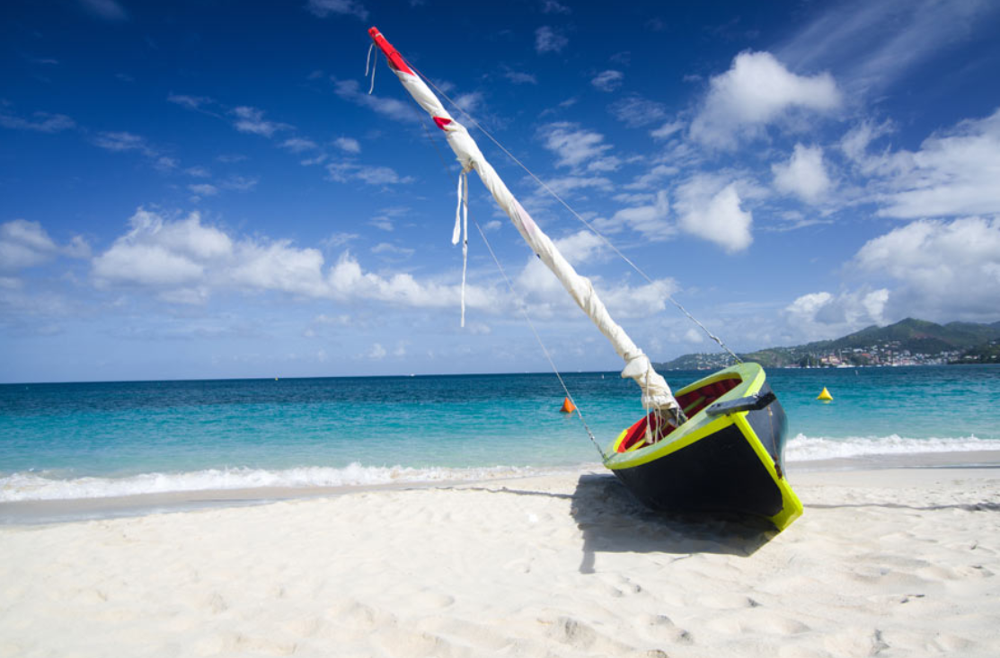

Grenada: The Country
Archipelago of Islands
Spice Island
Tropical Climate: 21C – 28C
Pristine White Sand Beaches
Hospitable & Friendly People
Lowest Crime Rate
Pro-Business Policies

Slide 9
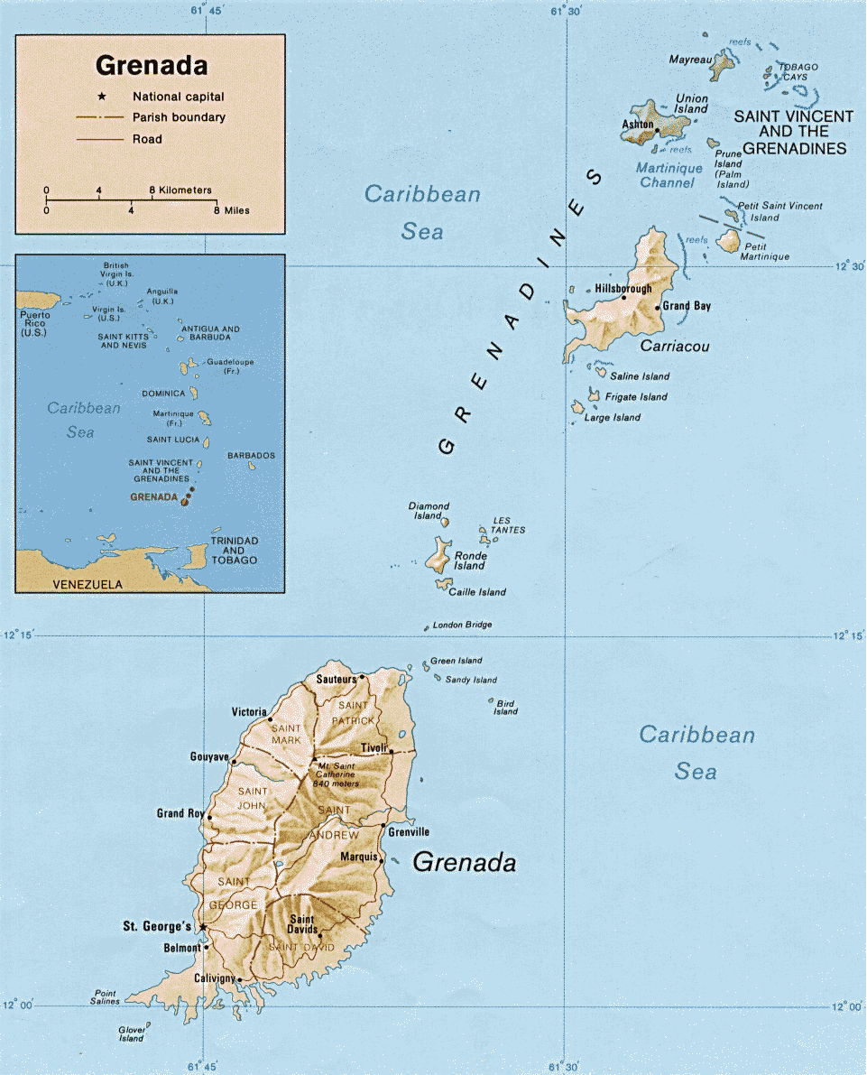
Grenada: The Country
Land Mass: 344 sq km
Population: 110,000
GDP (PPP): $1.4B
Per Capita GDP (PPP): $13,000
Human Development Index: 63rd
Nutmeg Exports: 2nd largest
Doing Business Rank / Construction Permits #9
Doing Business Rank / Starting a Business #72

Slide 10
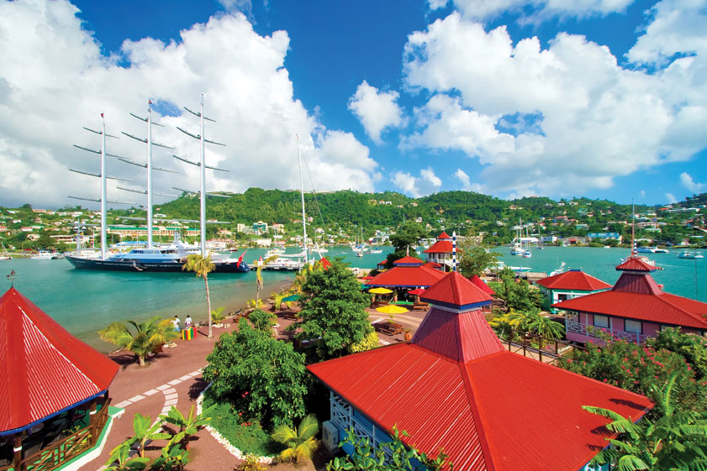
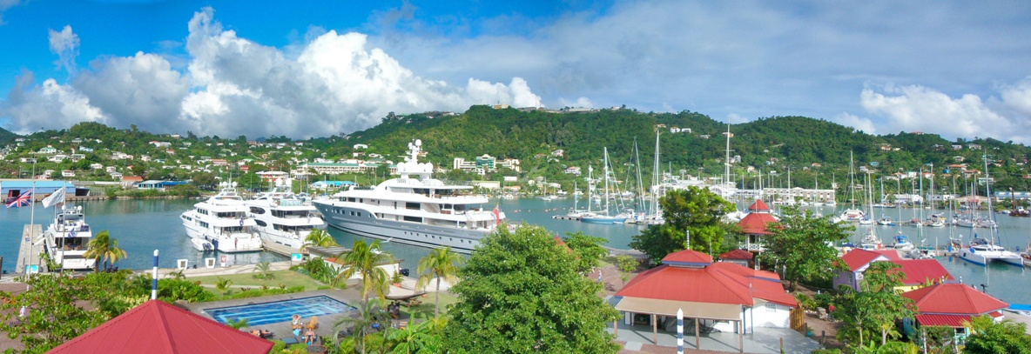

Super Yacht Port
Gateway to the Grenadines

Slide 11
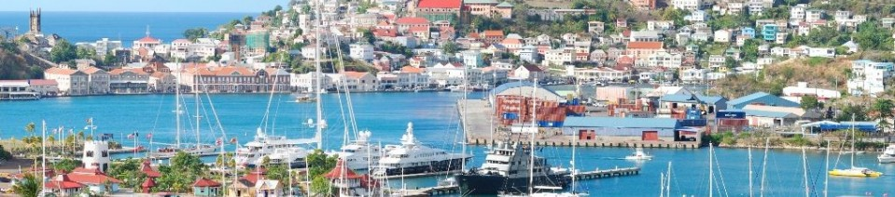
Super Yacht Port & Regional Port
Gateway to the Grenadines & Caribbean
Challenge: Move the Existing Port Facility
Opportunity 1: Build a new Super Yacht port
Opportunity 2a: Build a new regional trading port
Opportunity 2b: Operate a regional ferry service

Slide 12
Super Yacht Port & Regional Port
Gateway to the Grenadines & Caribbean
Opportunity 1: Build a new Super Yacht port $125 Million
Opportunity 2a: Build a new regional trading port $150 Million
Opportunity 2b: Operate a regional ferry service $ 7 Million

Slide 13
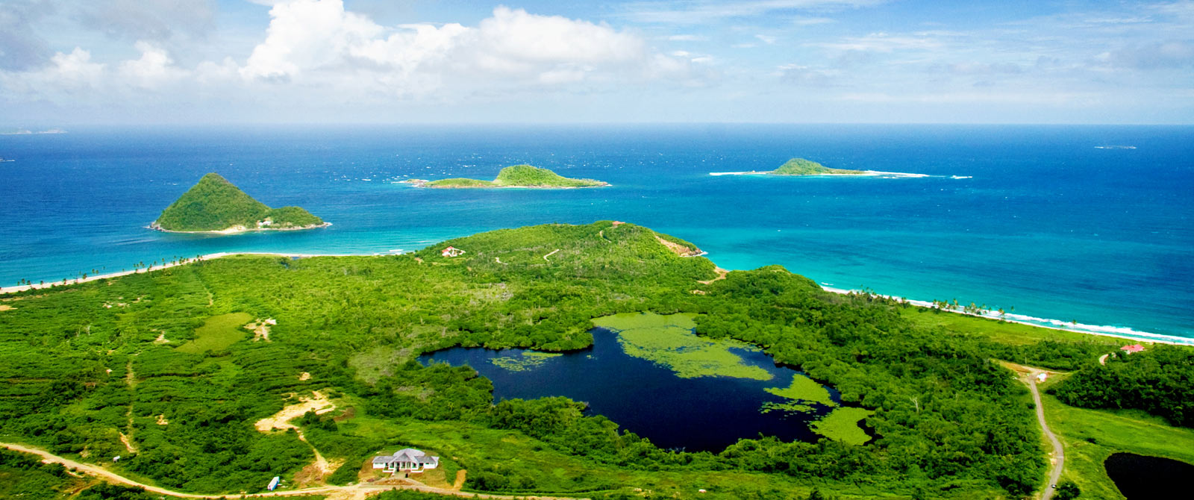
Grenada Gateway Opportunities
Benefits
Tax Exemptions
Citizenship for Investors
Western Hemisphere base
Lifestyle
Education
Thank You. ambassador@grenadaembassyusa.org

