Slide 1

INVEST IN JAMAICA
Presentation by:
His Excellency Ralph Thomas
Ambassador of Jamaica
“Going to Latin America Forum, Guanzhou
February 25-26 2014

Slide 2
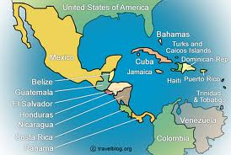
Gateway to the Americas
Near to market of 800 million persons
Modern Airports
Transhipment Ports
Cruise Shipping Ports
Solid Information & Telecommunications infrastructure
Located 1 hour from Cuba, 90 minutes to Miami, USA
Notes:
PAGE 2 OF SCRIPT

Slide 3
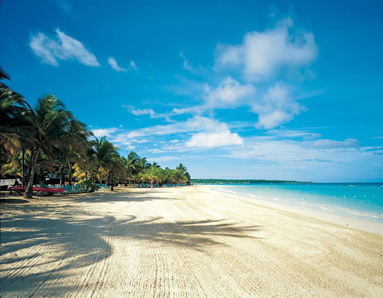
Overview of Jamaica
Population: 2.8 million
Largest English speaking island in the Caribbean
GDP per Capita: US$8,300
Literacy Rate: 87.9%
Political stability
Economic stability
Laws & Regulations to protect Investments in Economic Free-zones
Notes:
PAGE 2 OF SCRIPT

Slide 4
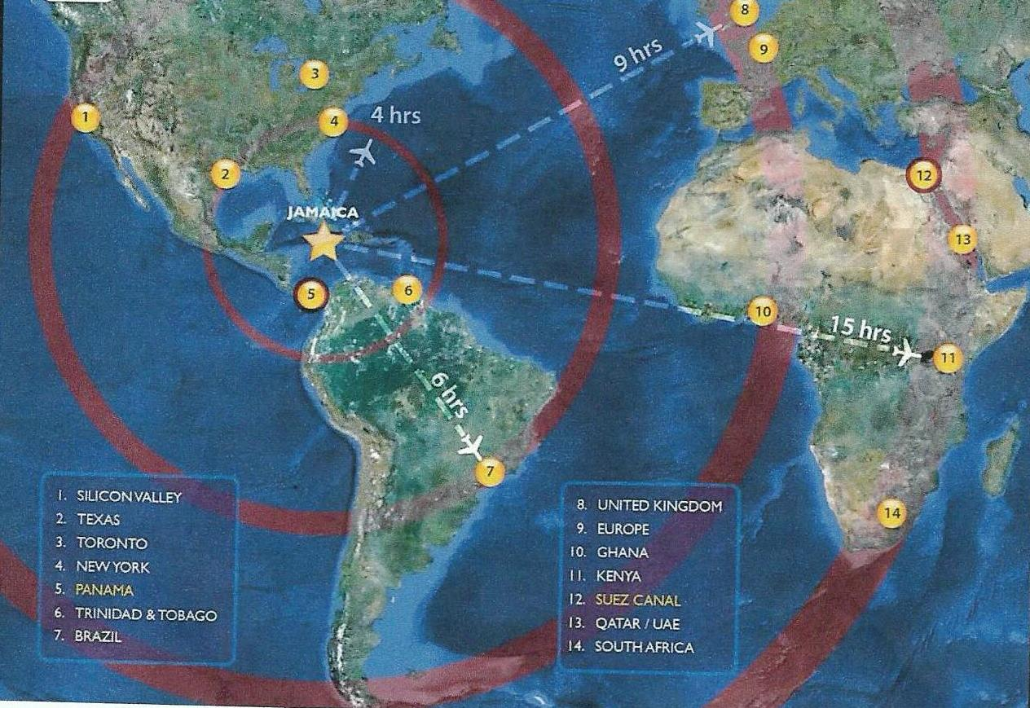
Ideal Geographic Location
Notes:
PAGE 3 OF SCRIPT

Slide 5
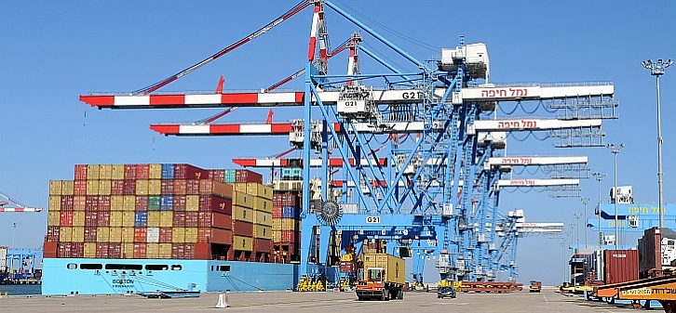
Why Jamaica Logistics Hub?
Jamaica has location advantage created by its close proximity to International Shipping Lanes
Deep water port can accommodate new class of Post-Panamax ships and facilitate transhipment
New investments planned to expand port and build new Logistic facilities
Notes:
PAGE 3 OF SCRIPT

Slide 6
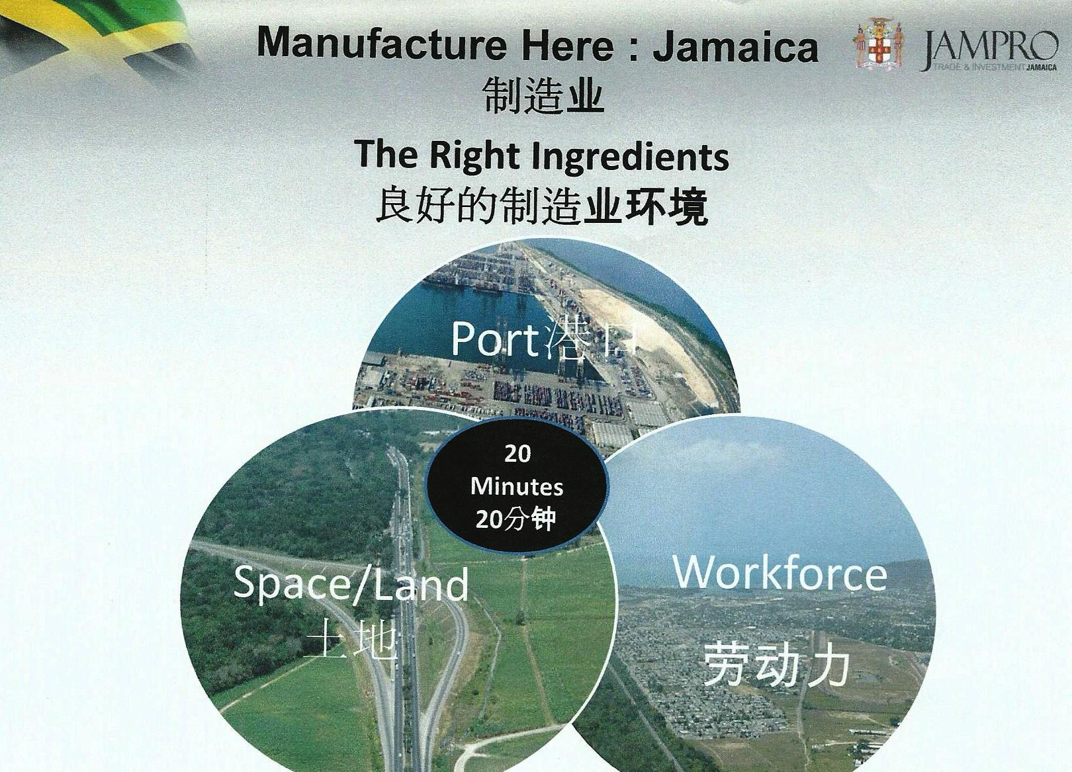
Global Supply Chain Advantages
SEA, ROAD, AIR-LINKS
FREEZONES
AIR CARGO
FREEZONE
SHIP
REPAIR
FACILITIES
BONDED WAREHOUSE
BULK GRAIN
STORAGE
PETROLEUM
STORAGE
FACILITIES
Notes:
PAGE 4 OF SCRIPT

Slide 7
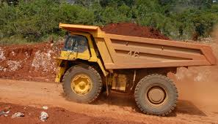
Investment Opportunities
Infrastructure; construction of
roads, port facilities
Housing
Agriculture
Tourism /Hotels
Water and sewer
projects
Bauxite Mining & Alumina production
Agro-business
Notes:
PAGE 3 OF SCRIPT

Slide 8
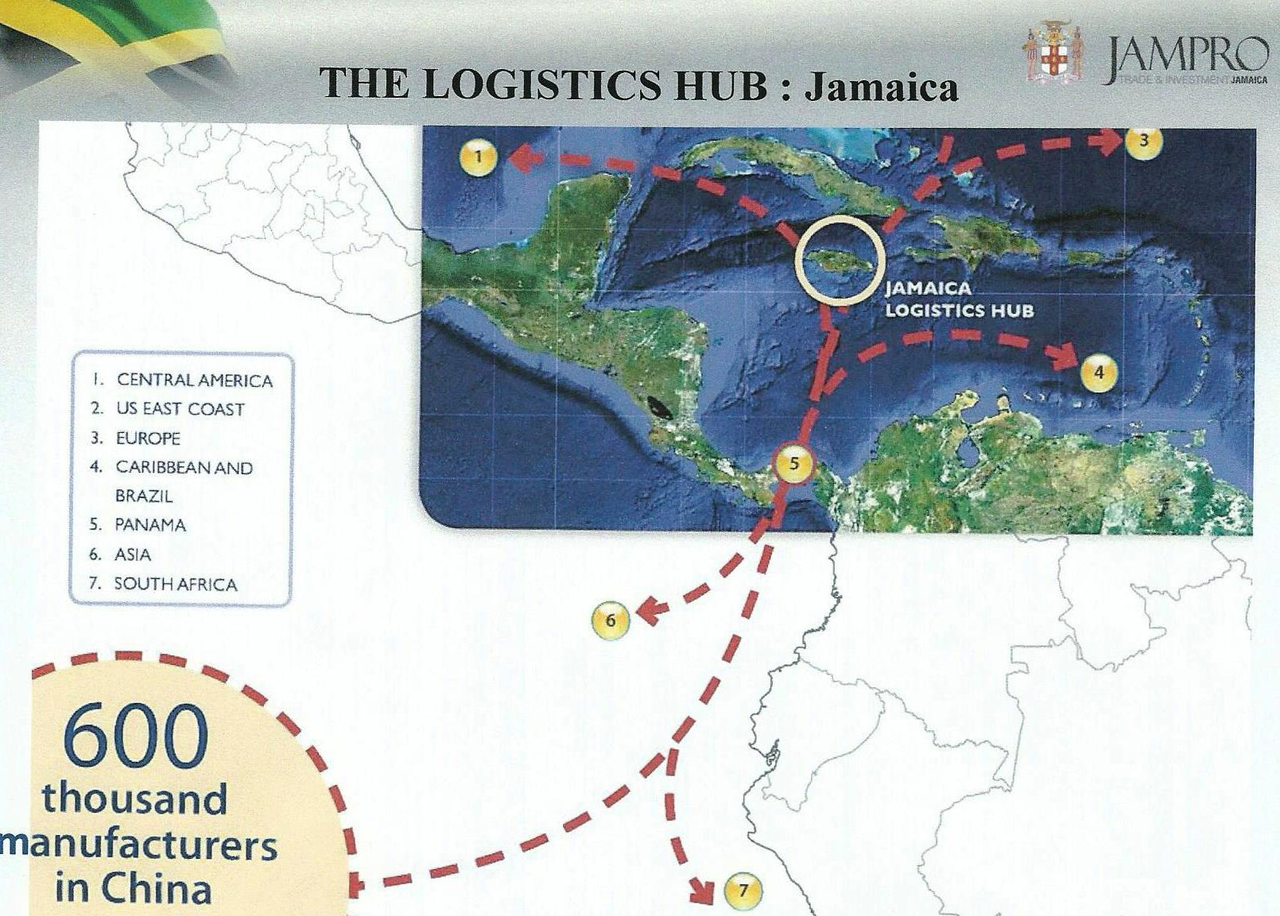
Location advantage - Shipping route from China to markets
Notes:
PAGE 4 OF SCRIPT

Slide 9
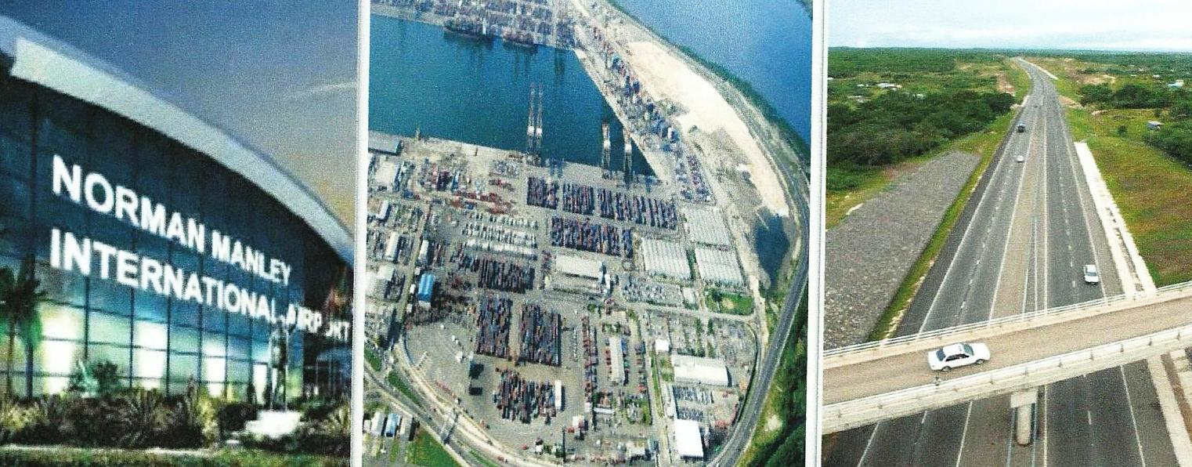
Investment Opportunities
Invest in Logistic Hub
Assemble, warehouse and distribute from Tax advantaged Industrial Parks
Regional Office for Latin America & Caribbean operations
Government Incentives for Investment
Notes:
PAGE 4 OF SCRIPT

Slide 10
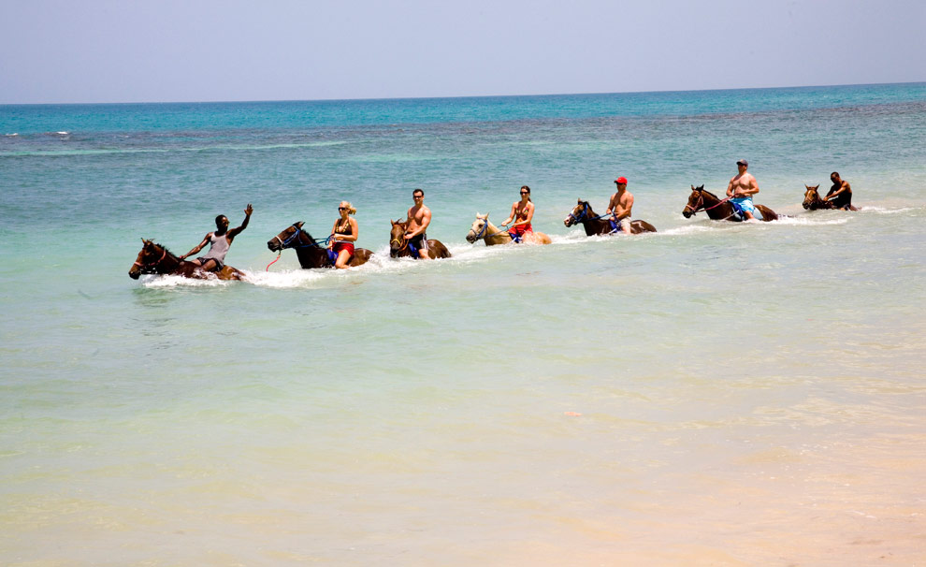
Jamaica is a choice Tourist destination

Slide 11
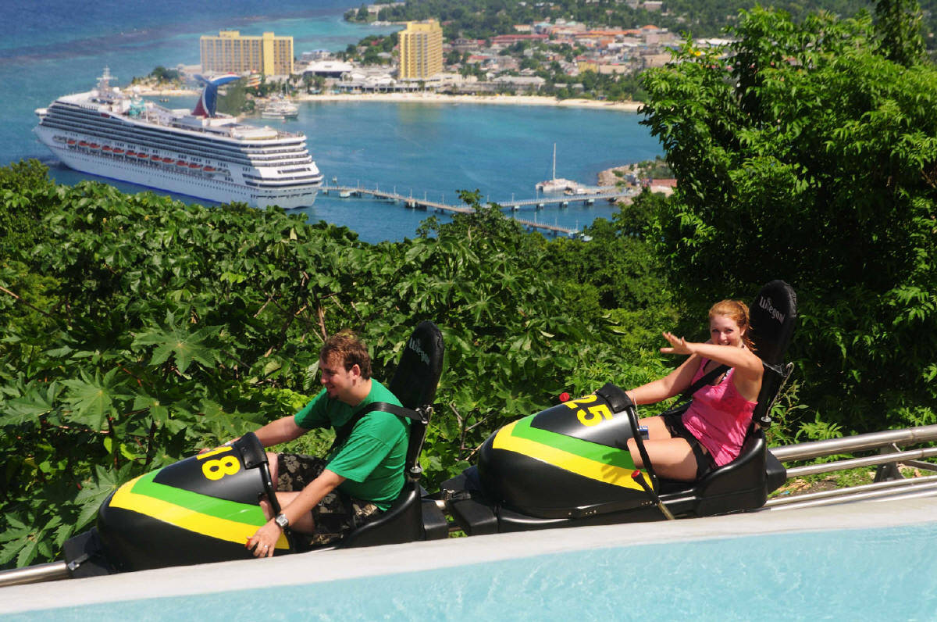
COME TO JAMAICA AND FEEL ALLRIGHT !
Horseback Riding
CRUISE SHIPPING INVESTMENTS
ATTRACTIONS, ENTERTAINMENT
GOLF COURSES
CASINOS AND GOLF INVESTMENTS
HOTEL INVESTMENTS
AGRO-TOURISM
ECO-TOURISM
HEALTH & WELLNESS TOURISM

Slide 12
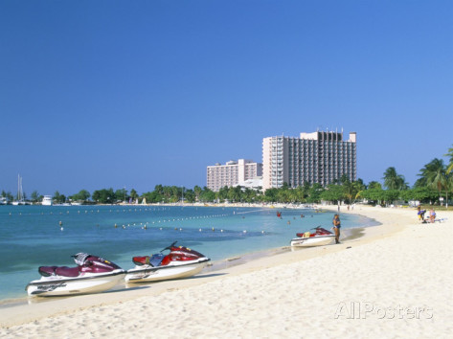
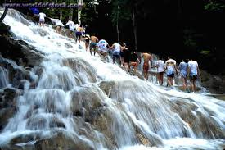
Tourist Hotels and Attractions
H
New Investment Opportunities
Notes:
PAGE 5 OF SCRIPT

Slide 13
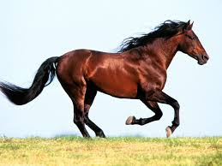

Stay in front of the Competition
Be a Winner
Notes:
PAGE 5 OF SCRIPT

Slide 14

“Let us share this Vision of new and expanded opportunity for expanding the flow of investments to our region and to beautiful and exciting Jamaica”
Ambassador Thomas
http://www.embassy@jamaicagov.cn
http://www.jamaicatradeand invest.org/chinese
Notes:
PAGE 5 OF SCRIPT

