Slide 1
Global Corporate Branding
Bill Black
President, Greater Washington China Investment Center
September 10th, 2014

Slide 2
$2.9 Trillion

Slide 3
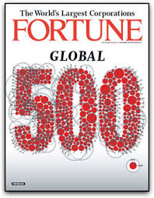
Chinese Companies Comprise 20% of Fortune 500

Slide 4
No Chinese Companies

Slide 5
Do Brands Matter?

Slide 6
The Value of a Good Brand
Increased sales
Price
Competitive advantage
Protection in crisis
Company value

Slide 7
Brand versus Reputation

Slide 8
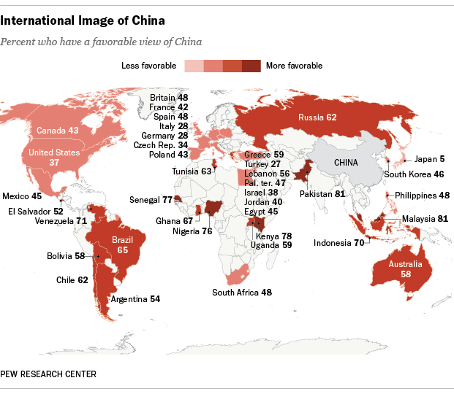
Overcoming Brand China

Slide 9
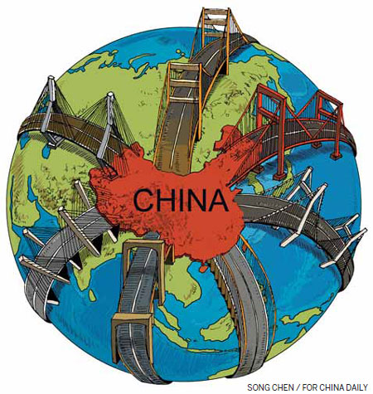

Slide 10
Thank you

