Slide 1
WHY INVEST IN PERU?
GUANGZHOU, CHINA
February 25, 2014
Mr. Gonzalo Gutierrez
Ambassador of Peru in China

Slide 2
WHY INVEST IN PERU?
Internationally acknowledged macroeconomic soundness
Friendly investment environment
Open trade and market access policy
4. Attractive sectors to Invest
Notes:
Sin duda la crisis financiera internacional afecta las perspectivas de inversión en el mundo y lleva a los expertos a evaluar los proyectos propuestos con mayor cuidado, lo cual no implica que las empresas puedan dejar de pensar en sus desarrollos de largo plazo.
En este contexto, el Perú destaca como un destino de inversión que vale la pena evaluar. Las razones se pueden resumir en 4 campos básicos:
Estabilidad macroeconómica: la economía peruana presenta excelentes resultados siendo uno de los países mejor preparados para enfrentar la crisis global.
Clima favorable para la inversión: el país ha consolidado uno de los marcos legales más modernos y atractivos para la inversión extranjera responsable.
Acceso a mercados: el Perú ha establecido una amplia red de acuerdos comerciales que le aseguran acceso preferente a prácticamente todos los mercados más dinámicos del mundo.
Desarrollo de infraestructura: el crecimiento exponencial del comercio internacional peruano está generando un sustantivo aumento de la demanda por infraestructura y servicios logísticos. En ese sentido el Estado peruano viene desarrollando obras de infraestructura de importante magnitud en las cual promueve la participación del sector privado. Ello permitirá elevar nuestra competitividad y proyectarnos como una eficiente plataforma productiva y comercial en el Pacífico Sudamericano.
2

Slide 3
MACROECONOMIC SOUNDNESS

Slide 4
MACROECONOMIC SOUNDNESS
Peruvian economy rise rapidly in the last decade …
Real GDP, 2002-2014*
(Variation %)
Real GDP 1952-2011
(aver annual var. %)
GDP , 2002-2014*
(USD thousands of million )
Source: Central Reserve Bank of Peru, Ministry of Economy and Finances and IMF
* Estimated figures of BCRP
Notes:
Para el 2009 se proyecta una tasa de crecimiento algo menor a la registrada durante los años previos, pero que se mantendría cercana al 5% anual según el MEF y se proyecta que volvería a incrementarse en los dos años siguientes.
Tales proyecciones se sustentan en 3 factores claves:
Los compromisos de inversión extranjera directa en proyectos en ejecución que en total superan US$ 8 mil millones de dólares al año.
La disposición de las autoridades para ejecutar una política fiscal contra-cíclica, gracias a los sólidos fundamentos presupuestales y al manejo de deuda.
La viabilidad de mantener el ritmo de préstamos para inversión local y de vivienda en vista de la buena condición del sistema bancario.
Con ello, al 2011 se concretaría un ciclo de 10 años consecutivos de crecimiento acelerado.
Estas proyecciones realizadas por el Ministerio de Economía y Finanzas se ven además respaldadas por fuentes externas como la CEPAL (siguiente diapositiva).

Slide 5
MACROECONOMIC SOUNDNESS
ESTABILIDAD MACROECONÓMICA
MACROECONOMIC STABILITY
Economic growth has been driven by rising private investment….
Private Investment 2002-2014
(Annual average variation %)
Private Investment 2002-2014
(US$ Billion)
Source: Central Reserve Bank of Peru and Ministry of Economy and Finance
* * BCRP Estimated figures (inflation report, December 2013) and MEF (MMM 2014-2016)
Notes:
Tales proyecciones se sustentan en 3 factores claves:
Los compromisos de inversión extranjera directa en proyectos en ejecución que en total superan US$ 8 mil millones de dólares al año.
La disposición de las autoridades para ejecutar una política fiscal contra-cíclica, gracias a los sólidos fundamentos presupuestales y al manejo de deuda.
La viabilidad de mantener el ritmo de préstamos para inversión local y de vivienda en vista de la buena condición del sistema bancario.
Con ello, al 2011 se concretaría un ciclo de 10 años consecutivos de crecimiento acelerado.

Slide 6
MACROECONOMIC SOUNDNESS
Private investment today represents almost 22% of GDP ….
Total investment 2002-2014
(% of GDP)
Total investment – LATAM 2013
(% of GDP)
Peru Chile Mexico Argentina Colombia Brazil
Source: Central Reserve Bank of Peru
Source: International Monetary Fund and Central Reserve Bank

Slide 7
MACROECONOMIC SOUNDNESS
ESTABILIDAD MACROECONÓMICA
MACROECONOMIC STABILITY
Investment announcement 2014-2015 reach US$ 29 million
Private Investment projects 2014-2015
(US$ million )
 | Set.13 | Dic.13 | Differences
Mining | 13,880 | 14,110 | 230
Hidrocarbons | 3,797 | 4,036 | 239
Electricity | 2,813 | 3,293 | 480
Industry | 1,671 | 1,991 | 320
Infrastructure | 1,133 | 1,133 | 0
Other sectors | 3,431 | 3,952 | 521
Total | 26,725 | 28,515 | 1,790
Source: BCRP. Inflation report, December 2013

Slide 8
MACROECONOMIC SOUNDNESS
… Peru is an attractive market for foreign investment, which
Register a 12,000 millions in 2012
Foreign direct investment flow 2002 - 2014
(US$ Billion)
Foreign direct investment – LATAM 2012 /1
(% GDP)
Source: Central Reserve Bank of Peru (BCR)
Source: IDB
1/ Peru and Chile are closing figures
Source: BCR and Central Reserve Bank of Chile

Slide 9
MACROECONOMIC SOUNDNESS
…Furthermore, the domestic demand is strengthening ….
Real domestic demand 2002 - 2014
(real annual Var. % )
Imports of vehicles
for private use
(US$ million)
Imports of domestic assets
(US$ million)
4 veces
Times
10 veces
Times
Source: SUNAT and MEF
Estimated figures
1/ Includes imports of refrigerators, lavadoras, televidores y electrodomésticos.
Source: Central Reserve Bank of Peru and SUNAT

Slide 10
MACROECONOMIC SOUNDNESS
…generating an increase in consumer markets
Malls
(Number per region)
Mall’s Sales
(Million of US$)
4 times
3 veces
Source: MEF y ACCEP
E/ expected figure
P/ proyection

Slide 11
MACROECONOMIC SOUNDNESS
ESTABILIDAD MACROECONÓMICA
MACROECONOMIC STABILITY
Complemented with a dynamic international trade…
Balance of Trade 2002-2014
(US$ million)
Exports
Imports
Trade Balance
Source: Central Reserve Bank of Peru
Notes:
Tales proyecciones se sustentan en 3 factores claves:
Los compromisos de inversión extranjera directa en proyectos en ejecución que en total superan US$ 8 mil millones de dólares al año.
La disposición de las autoridades para ejecutar una política fiscal contra-cíclica, gracias a los sólidos fundamentos presupuestales y al manejo de deuda.
La viabilidad de mantener el ritmo de préstamos para inversión local y de vivienda en vista de la buena condición del sistema bancario.
Con ello, al 2011 se concretaría un ciclo de 10 años consecutivos de crecimiento acelerado.

Slide 12
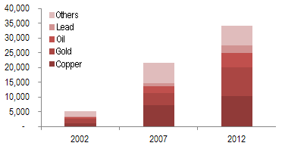
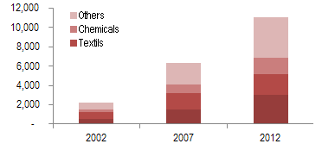
MACROECONOMIC SOUNDNESS
ESTABILIDAD MACROECONÓMICA
MACROECONOMIC STABILITY
… which is being diversifying, both in products and markets
Traditional Exports(commodities)
(Millions of US$)
Main trading partners
6 veces
2002
6 times
Non-Traditional Exports
(Millions of US$)
2012
5 times
Source: Central Bank of Reserve of Peru

Slide 13
MACROECONOMIC SOUNDNESS
In 2050, Peru will be one of the fastest growing economies ranking among the 30 main economies in the world…
Fastest growing economies
Economy size – World ranking
2050
Ranking | Country
1 | China
2 | India
3 | Philippines
4 | Egypt
5 | Malaysia
6 | Peru
2010
Ranking | Country
1 | USA
2 | Japan
3 | China
4 | Germany
5 | United kingdom
6 | France
7 | Italy
8 | India
9 | Brazil
10 | Canada
44 | Chile
46 | Peru
2050
Ranking | Country
1 | China
2 | USA
3 | India
4 | Japan
5 | Germany
6 | United kingdom
7 | Brazil
8 | Mexico
9 | France
10 | Canada
26 | Peru
32 | Chile
Source: HSBC (January 2012)
Notes:
13
En cuanto a la posición externa…
La responsable política económica, que ha mantenido continuidad a través de la sucesión de gobiernos democráticos, ha permitido acumular reservas internacionales que cubren en exceso la deuda externa, fortalecer el sistema financiero (muy baja morosidad), mantener un importante superávit fiscal y reducir el ratio deuda-PBI, lo cual coloca al Perú en mejores condiciones que muchos otros países en el mundo para afrontar el actual escenario de crisis internacional.
Perú ha venido registrando superávit presupuestales por varios años y el nivel de su deuda pública es bajo. De hecho, Perú es uno de los pocos países donde las reservas internacionales del Banco Central (US$ 31 mil millones o 26% del PBI) exceden el total de la deuda pública interna y externa (US$ 30 mil millones).
Finalmente, cabe anotar que ante un escenario de mayor volatilidad, donde aumenta la percepción del riesgo sobre las economías emergentes, el Perú sigue manteniendo un nivel de riesgo país por debajo del promedio regional y ha podido alcanzar (desde julio de 2008) que 3 agencia clasificadoras de riesgo (Standard & Poors, Fitch Ratings y la agencia canadiense Dominion Bond Rating Service) lo posicionen como país con grado de inversión.
En cuanto a la posición externa…
La responsable política económica, que ha mantenido continuidad a través de la sucesión de gobiernos democráticos, ha permitido acumular reservas internacionales que cubren en exceso la deuda externa, fortalecer el sistema financiero (muy baja morosidad), mantener un importante superávit fiscal y reducir el ratio deuda-PBI, lo cual coloca al Perú en mejores condiciones que muchos otros países en el mundo para afrontar el actual escenario de crisis internacional.
Perú ha venido registrando superávit presupuestales por varios años y el nivel de su deuda pública es bajo. De hecho, Perú es uno de los pocos países donde las reservas internacionales del Banco Central (US$ 31 mil millones o 26% del PBI) exceden el total de la deuda pública interna y externa (US$ 30 mil millones).
Finalmente, cabe anotar que ante un escenario de mayor volatilidad, donde aumenta la percepción del riesgo sobre las economías emergentes, el Perú sigue manteniendo un nivel de riesgo país por debajo del promedio regional y ha podido alcanzar (desde julio de 2008) que 3 agencia clasificadoras de riesgo (Standard & Poors, Fitch Ratings y la agencia canadiense Dominion Bond Rating Service) lo posicionen como país con grado de inversión.

Slide 14
MACROECONOMIC SOUNDNESS
...and has accumulated international reserves for a third of the GDP
Net International Reserves
(US$ Billion)
International reserves indicators
 | November
 | 2003 | 2008 | 2013
NIR ( US$ million) | 10,303 | 30,970 | 66,279
Posición de Cambio del BCRP (US$ million) | 4,367 | 21,017 | 42,151
NIR / GDP (%) ^{1/} | 17.1 | 24.4 | 32.0
NIR /GDP Deuda externa de corto plazo (N° times) ^{2/} | 2.2 | 3.3 | 9.0
1/ Acumulado al trimestre inmediatamente anterior.
2/ Incluye el saldo de deuda de corto plazo y la amortización de los próximos cuatro trimestres
Source: BCRP. Inflation report December 2013

Slide 15
MACROECONOMIC SOUNDNESS
The responsible economic policy granted Peru the investment grade and investors’ confidence.
Investment grade
Latin America benchmarking
Countries as priority destinations for FDI 2011-2013
(World Ranking among 21 countries)
Country | S&P | Fitch | Moody´s
Chile | AA- | A+ | Aa3
Mexico | BBB+ | BBB+ | Baa1
Peru | BBB+ | BBB+ | Baa2
Brazil | BBB | BBB | Baa2
Colombia | BBB | BBB | Baa3
Dropped 1 position
Improved 5 positions
Without changes
Source: Standard & Poor`s, Fitch Ratings and Moody´s.
Updated as of October 23, 2013
Source: UNCTAD (WIR 2011)
Notes:
15
En cuanto a la posición externa…
La responsable política económica, que ha mantenido continuidad a través de la sucesión de gobiernos democráticos, ha permitido acumular reservas internacionales que cubren en exceso la deuda externa, fortalecer el sistema financiero (muy baja morosidad), mantener un importante superávit fiscal y reducir el ratio deuda-PBI, lo cual coloca al Perú en mejores condiciones que muchos otros países en el mundo para afrontar el actual escenario de crisis internacional.
Perú ha venido registrando superávit presupuestales por varios años y el nivel de su deuda pública es bajo. De hecho, Perú es uno de los pocos países donde las reservas internacionales del Banco Central (US$ 31 mil millones o 26% del PBI) exceden el total de la deuda pública interna y externa (US$ 30 mil millones).
Finalmente, cabe anotar que ante un escenario de mayor volatilidad, donde aumenta la percepción del riesgo sobre las economías emergentes, el Perú sigue manteniendo un nivel de riesgo país por debajo del promedio regional y ha podido alcanzar (desde julio de 2008) que 3 agencia clasificadoras de riesgo (Standard & Poors, Fitch Ratings y la agencia canadiense Dominion Bond Rating Service) lo posicionen como país con grado de inversión.
En cuanto a la posición externa…
La responsable política económica, que ha mantenido continuidad a través de la sucesión de gobiernos democráticos, ha permitido acumular reservas internacionales que cubren en exceso la deuda externa, fortalecer el sistema financiero (muy baja morosidad), mantener un importante superávit fiscal y reducir el ratio deuda-PBI, lo cual coloca al Perú en mejores condiciones que muchos otros países en el mundo para afrontar el actual escenario de crisis internacional.
Perú ha venido registrando superávit presupuestales por varios años y el nivel de su deuda pública es bajo. De hecho, Perú es uno de los pocos países donde las reservas internacionales del Banco Central (US$ 31 mil millones o 26% del PBI) exceden el total de la deuda pública interna y externa (US$ 30 mil millones).
Finalmente, cabe anotar que ante un escenario de mayor volatilidad, donde aumenta la percepción del riesgo sobre las economías emergentes, el Perú sigue manteniendo un nivel de riesgo país por debajo del promedio regional y ha podido alcanzar (desde julio de 2008) que 3 agencia clasificadoras de riesgo (Standard & Poors, Fitch Ratings y la agencia canadiense Dominion Bond Rating Service) lo posicionen como país con grado de inversión.

Slide 16
FRIENDLY INVESTMENT ENVIRONMENT

Slide 17
FRIENDLY INVESTMENT ENVIRONMENT
Peru offers a favorable legal framework for foreign investment:
Non discriminatory treatment: Foreign investors receive the same treatment as local investors.
Unrestrictive access to most economic sectors *.
Free transfer of capital.
Free competition.
Guarantee for Private Property.
Freedom to purchase stocks from locals.
Freedom to access internal and external credit.
Freedom to pay royalties.
Network of investments agreements and member of ICSID and MIGA.
Peru participates in the Investment Committee of the Organisation for Economic Co-operation and Development (OECD) – It promotes the implementation of the Guidelines for Multinational Enterprises.
*Investments that require authorization: Located within 50 km in the frontier line and those destined to arms, ammunitions and explosive. Likewise, a principal local partner for investments in maritime cabotage as well as in air transport is required.

Slide 18
FRIENDLY INVESTMENT ENVIRONMENT
Special Regimes: Legal Stability Agreements
Regime whereby the Peruvian Government guarantees:
INVESTORS
Stability of the regulations regarding non discriminatory treatment.
Stability of the income tax regime applicable to dividends.
Stability to use freely the most favorable exchange rate available in the market.
Stability of the free availability and remittance of foreign currency, dividends and royalties regime.
RECEIVING COMPANY
Stability of the recruitment regimes.
Stability of the regimes for the promotion of exports.
Stability of the Income Tax Regime
Requirement: Minimum investment of US$ 5 million in any economic sectors. US$ 10 million for hydrocarbon and mining sectors.
Validity: 10 years. Concessions: Term according to the contracts life (Max. 60 years).

Slide 19
FRIENDLY INVESTMENT ENVIRONMENT
Special Regime: VAT Anticipated Recovery.
Regime whereby the Peruvian Government grants the following benefits:
Granting the return of the Value Added Tax during the pre-productive stage of the project (minimum 2-year term).
Applicable to all economic sectors
For agricultural activity it is not necessary to meet a minimum investment amount. For other activities the minimum investment amount is US$ 5 million.
The project can be divided into stages, phases or similar.

Slide 20
A steady tax regime:
FRIENDLY INVESTMENT ENVIRONMENT
Tax |  | Applicable Rate
INCOME | Corporate profits | 30.0%
 |  | Agriculture, agribusiness and aquaculture 15%
 | Dividends | 4.1%
 | Royalties | 30.0%
 | Interest rate on loans from abroad | 4.9%
Value Added Tax (VAT) |  | 18%
Financial Transactions Tax |  | 0.005%
Temporary to net assets, applicable to the excess of S/. 1 000 000 |  | 0.4%

Slide 21
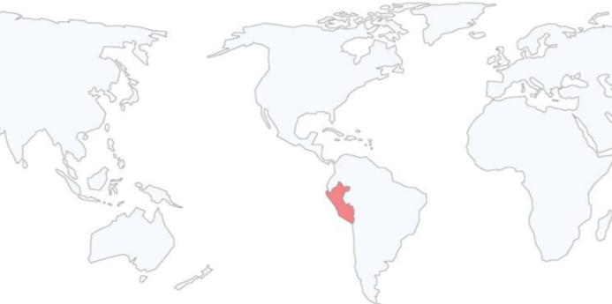
FRIENDLY INVESTMENT ENVIRONMENT
Investment Agreements
Peru has signed and currently in force Agreements for the Promotion and Reciprocal Protection of Investment and Trade Agreements of further scope that includes investment chapters that underpin our liberalization policy.
Germany
Belgium and Luxemburg
Denmark
Spain
Finland
France
Netherlands
Iceland*
Italy
Liechtenstein*
Norway
Portugal
United Kingdom
Czech Republic
Romania
Sweden
Switzerland*
Canada*
United States*
Australia
China*
Korea*
Malaysia
Singapore*
Thailand
Japan
Cuba
El Salvador
Argentina
Bolivia
Chile*
Colombia
Ecuador
Paraguay
Venezuela
* Trade agreements
It has also signed agreements to avoid double taxation with Andean Community, Brazil, Chile and Canada.
Notes:
21

Slide 22
OPEN TRADE AND MARKET ACCESS POLICY

Slide 23
Reduced tariff structure with low tariff dispersion
3. FRIENDLY INVESTMENT ENVIRONMENT
LEVELS OF ADVALOREM | TARIFF LINES 2/
 | NUMBER | PROPORTION (%)
0 | 4,224 | 55.9%
6% | 2,538 | 33.6%
11% | 792 | 10.5%
Total | 7,554 | 100 %
EFFECTIVE AVERAGE TARIFF % |  | 3.2
EFFECTIVE TARIFF % |  | 1.1
STANDARD DEVIATION % |  | 3.8
2/ Sub-tariff of Chapter 98 Goods with special treatment of duties tariff
Source: SUNAT – MEF

Slide 24
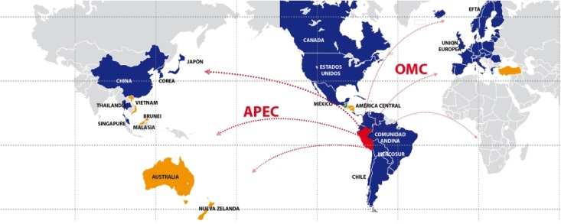
OPEN TRADE AND MARKET ACCESS POLICY
Working to become a globalized economy,
with preferential access to the world’s largest markets
These countries stand for enlarged market of over 4 billion people with a joint GDP over US$ 56 billion 96% of Peruvian exports
Agreements in force
Agreements under negotiations
Notes:
24
Un tercer factor de importancia a tomar en cuenta para evaluar al Perú con destino de inversiones es su activa política de integración comercial con el mundo.
A través de diversos esquemas de integración, se ha logrado el acceso a importantes mercados ampliados, hacia los cuales podrá acceder el inversionista que se establezca en el país. Ejemplo de ello son los Tratados de Libre Comercio suscritos con Estados Unidos, Canadá, Singapur y China, y el Acuerdo con Tailandia. Destacar que el tratado con Estados Unidos entró en plena vigencia el 1 de febrero de este año y se negocian otros tratados con la Unión Europea, EFTA y Corea.
El Perú es además miembro de la Comunidad Andina de Naciones y mantiene también preferencias arancelarias con la mayoría de los países latinoamericanos como México, Chile, Mercosur, etc.
Es meta del Perú convertirse en el principal hub de negocios o plataforma exportadora en la región del Pacífico Sudamericano.

Slide 25
INVESTMENT OPPORTUNITIES IN ATTRACTIVE SECTORS

Slide 26
AGRIBUSINESS SECTOR
Natural greenhouse.
High agricultural yields: Sugarcane (2nd), Asparagus, Olives (3rd), Artichokes (4th), Grapes (6th) and Avocado (11th).
Seasonal windows in major markets.
The 100,000 ha of land currently devoted to agricultural exports are expected to double as a result of large agricultural irrigation and expansion existing projects.
More than US$ 4.000 billion in exports of fresh and processed products to more than 145 countries.
Organic and Natural Products with high export potential.
Notes:
26
26
Dry tropics with vertical sunlight generates an artificial Greenhouse with adequate lighting and temperature difference during the day and night.
Best crop yields in the world:
Sugarcane (1st),
Asparagus, Olives and Artichokes (3rd),
Grapes (5th)
Access to "seasonal windows" in the most important markets with rewards on prices.
Irrigation projects will enable to expand the 90,000 ha dedicated to agro exports.
Majes Siguas: 38,000 Ha
Olmos: 35,000 Ha
Chavimochic: 20,000 Ha
More than US$ 2.500 billion in exports of fresh and processed products to more than 113 countries.
Leading world exporter of asparagus, organic coffee and organic bananas.
Products with high export potential: Andean grains (amaranth, quinoa and tarwi), exotic fruits (chirimoya, aguaje and camu camu), berries, avocado, among others.
Potential of Coastal land for agricultural exports:
Tumbes: 30,000/ Basic food crops.
Piura: 50,000/ ethanol
Lambayeque:38,000/ Ongoing private initiative.
La Libertad: 20,000/ Chavimochic for export
8,000/ Export
10,000
Arequipa: 38,000/Majes II
8,000/Majes I
Total: 202,000

Slide 27
FISHING SECTOR
Extensive fishing coastline (3,080 km) and "bodies of water" which offer favorable conditions for the development of marine and continental aquaculture.
First worldwide exporter of fish oil.
Distribution of Peruvian fish products to over 100 countries.
Tendency to product diversification.
Notes:
27
27
Extensive fishing coastline (3,080 km) with zooplankton and phytoplankton abundance and confluence of ocean currents: Humboldt and El Niño, and "bodies of water" which offer favorable conditions for the development of marine and continental aquaculture.
Second producer and first largest exporter worldwide of fish meal and oil.
Distribution of Peruvian fish products to over 100 countries on five continents, among them China, Germany and Japan.
Tendency to product diversification
Continental Aquaculture: Trout, Tilapia, Shrimp, Squid, etc.
Marine Aquaculture: Scallops, Prawn, etc.

Slide 28
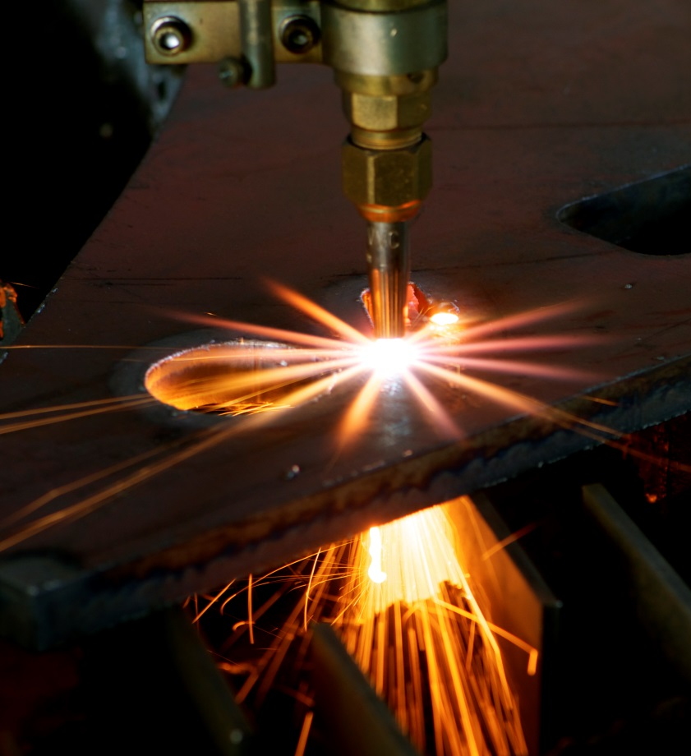
INDUSTRY
Manufacturing is the sector with highest weight (15.98%) in the formation of Peruvian GDP
Generates 11% of employment and represents more than 70% of non traditional exports with higher added value
One of the emblematic sub sectors is textile and clothing which has a long tradition of professionalism of workforce which has allowed the development o fan efficient comprehensive productive process
During 2014 the recovery of the economies of the main countries of destination of our exports and the greater demand of the internal market of intermediate goods foreseen a greater growth in this sector.
Notes:
Pima cotton use in the clothing industry sector, is a strategic differentiator for its extra-large and smooth strand, considered one of the most quoted and thin strands of the world.
Leading producer of the finest fibers of South American camelids: alpaca and vicuña, superior to the cashmere fiber.
Extensive textile tradition, promotes professionalism and training of the workforce, for farming activities and design and production processes.
International recognition as "full package" supplier of the best brands in the world of knitted cotton fabric.
Strong growth trend in exports, reaching its highest level in 2008: US$ 2,000 Million.
Brands served by Peruvian industries:
Abercrombie & Fitch; Izod Ara Intersales; JC Penny; Armani Exchange;
Nassino Dutti; Calvin Klein; Nautica Donna Karan Inc.; New Balance;
DKNY; Lacoste; Duck Head; Appared Co.; Kenneth Cole; Eddie Bauer;
Levy Strauss and Co.; Guess; Oakley; Inditex/Zara; Palacio de Hierro;
Polo Ralph Lauren; Ragman; Perry Ellis; International Reebok;
The Gymboree Corp.; Vanity Fair; Tommy Hilfiger; Saks Inc.

Slide 29
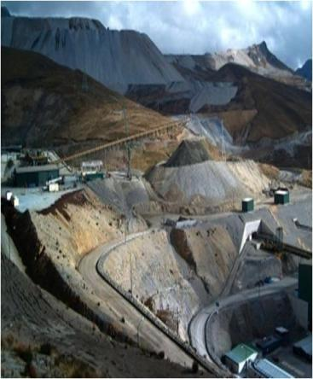
MINING SECTOR
Polymetallic country, second in world copper reserves, third in zinc, and first in silver.
In 2012, 15% of the land is subject of mining concessions, and only 1.09% of the land is taken for mining exploration and exploitation.
In 2012: Third producer of copper, silver, tin and zinc worldwide. First producer of gold, zinc, tin and lead. And 2nd of copper, silver and molybdenum in Latin America.
As of November 2013 metal exports totaled US$ 21,079 million, representing 55.27% of total national exports.
Peru is one of the few countries in the world with non-metallic mineral deposits, including diatomite, bentonite, limestone and phosphate.
Notes:
Polymetallic country, third in reserves of gold, silver, copper and zinc.
Only 20% of the territory with mining potential has been explored and 6% is currently being exploited.
World's largest producer of silver. And in Latin America:
1st producer of gold, zinc, silver, tin and lead.
2nd of copper and molybdenum.
Between 1999 and 2009, investment in the sector exceeded US$ 14.4 billion and that in the coming years investment projects would reach US$ 37 billion.
In Peru operate virtually all of the world's multinational mining companies.
Peru is one of the few countries in the world with non-metallic mineral deposit: diatomite, bentonite, borates.

Slide 30
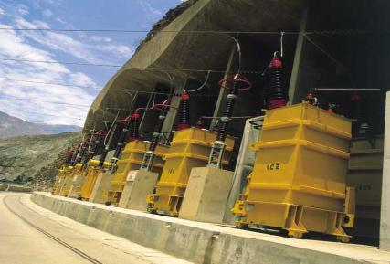
ENERGY SECTOR
Great energy potential: The wide availability of water resources and natural gas has enabled to meet the growing electricity demand in the country.
In 2012, 87.2% of the population had access to electricity.
The 2012 energy matrix, comes mostly from renewable energy (about 56% of energy production is hydroelectric, 43.5% is based on natural gas and 0.5% with other renewable sources).
Resources to be discovered and exploited: There are other renewable energy sources to be explored such as solar, wind, biomass and geothermal sources.
Power projects portfolio to be invested is over US$ 6.000 billion until 2016.
The main economic groups of power generation are: Endesa, GDF Suez, IC Power and Duke Energy.

Slide 31
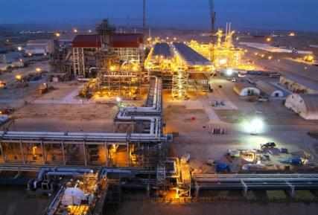
PETROCHEMICAL SECTOR
In 2013, natural gas production totaled 430,559 million cubic feet, driven by growing demand from power plants, increased consumption of vehicular (VNG), domestic and commercial natural gas.
Peru is the only sustainable source of natural gas in the South American Pacific area.
Peru has oil fields that have not been explored (29.97 million ha), making it a potential petrochemical hub.
The petrochemical industry integrates with the production of natural gas and other liquid hydrocarbons, giving it a significant added value.
Among the products produced by the Final Petrochemical Industry are nitrogen fertilizers, plastics and detergents, synthetic fibers and synthetic rubbers.
Investment opportunities for US$ 16.750 million in Nitratos del Perú, CF industries and Braskem petrochemical projects.

Slide 32
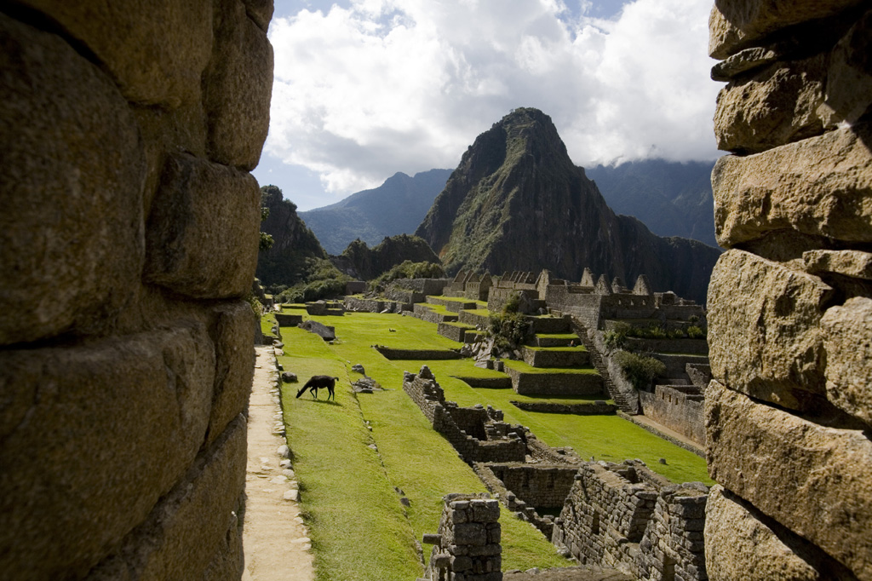
TOURISM SECTOR
Important cultural destination for archaeological sites of the Inca and pre-Inca cultures.Machu Picchu was voted one of the New 7 Wonders of the World.
Diversity of natural settings.
Destination for bird and orchid watchers.
Lima is considered the gastronomic capital of Latin America.
Important investment by internationally renowned hotel chains.
Increased connectivity of the Peruvian air market with increased weekly frequencies in international flights to allow more connections and destinations, with more and better travel options.
Investment Opportunities in the 8 priority destinations: Northern Beaches, Amazon River, Amazonas, Kuelap, Moche Route, Lima, Nazca, Paracas, Colca Valley and Puno-Lake Titicaca.
Due to its tourist attraction and services of quality Peru will be the venue of important sports events and international forum such as: APEC 2016 and the 2019 Pan American games.
Notes:
32
32
Important cultural destination for archaeological sites of the Inca and pre-Inca cultures.
Machu Picchu was voted one of the New 7 Wonders of the World.
Diversity of natural settings ranging from the beaches in the Pacific Coast to the Amazon Rainforest, through the Andes with peaks over 6,000 masl.
Essential destination for bird and orchid watchers, in which 1,730 bird species and more than 3,000 species of orchids live.
Lima is the gastronomic capital of Latin America with an offer of more than 10,000 restaurants that reflect the cultural diversity of the nation.
Significant investment of Hotels: Western, Hilton, among others.
Unexplored tourist attractions: Northeast Tourist Circuit: Kuelap, Sipan, Chan Chan, among others

Slide 33
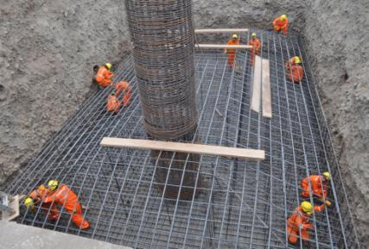
REAL ESTATE
The average growth of the sector in the last two years was 15.2 % corresponding to 2012 and 9.2% in 2013 %.
The significant growth of the economy is driving more investments in infrastructure as well as housing.
The housing shortage affects 20% of households.
There are several housing finance programs, subject to economic conditions and the level of household income, “Techo Propio”, “Fondo Mi Vivienda” and Commercial Banking.
Mortgage Loans have doubled over the past seven years (2006-2013), reaching US$ 10.600 million in December 2013

Slide 34
SERVICES - OUTSOURCING
The lowest labor costs per operator in Latin America (US$ 270), a factor that accounts for 60% of operating costs in contact centers.
Presently, contact centers represent 23,063 positions generating 36,479 direct jobs. In 2013 exports grew by 10%.
Exports of services from contact centers, data processing, computer application and programs and the likes are not subject to VAT.
Availability of technology requirements and low real estate costs.
The implementation of the Data Protection Act (passed in 2011) will strengthen the position of companies in the sector and will open new opportunities for the generation of larger business concerns.

Slide 35
TRANSPORT INFRASTRUCTURE
Peru has prioritized the development of transport infrastructure (road, rail, port and airport) to increase competitiveness and set up a logistics hub that integrates Latin America, with the Asia – Pacific economic region.
With this in mind, the commitments for investment in concessions of the sector, around US$ 7.4 billion as of September 2013, generating its modernization, with a reduction in logistics costs and driving, through the FTA, Peru's integration with global markets on a scale of greater competitiveness.
The developed infrastructure will be complemented by new investments planned towards 2016, by the MTC, having planned projects over US$ 20.5 billion (Public Works and PPA), which represents significant investment opportunities for contractors and operators.
Notes:
35
35
Important cultural destination for archaeological sites of Inca and Pre-Inca cultures.
Machu Picchu was voted one of the New 7 Wonders of the World.
Diversity of natural settings ranging from beaches on the Pacific Coast to the Amazon Rainforest, passing through the Andes with peaks above 6,000 above sea level.
Must-see destination for birdwatchers and orchid aficionados. 1,730 bird species and more than 3,000 species of orchids inhabit the country.
Lima is the gastronomic capital of Latin America, offering more than 10,000 restaurants that reflect the cultural diversity of the nation.
Significant investment of Hotels: Western, Hilton, amongst others.
Unexplored attractions: Northeast Tourist Circuit: Kuelap, Sipan, Chan Chan, amongst others

Slide 36
TRANSPORT INFRASTRUCTURE
New investment foreseen in transport infrastructure to 2013 – 2016
(US$ million including VAT)
Infrastructure | Public Work | PPP | Total
Vial (1) | 8,225 | 3,309 | 11,534
Waterways (2) |  | 76 | 76
Airports (3) |  | 776 | 776
Ports (4) |  | 548 | 548
Railways (5) |  | 7,627 | 7,627
Total | 8,225 | 12,336 | 20,561
Source : MTC
Includes public works and concessions, 7,270 km of paved roads, achieving 85% of the paved National Network, 100% of the Longitudinal de la Sierra road and construction and rehabilitation of bridges (PERU PRO BRIDGE Program)
(2) Waterways System Development of the Amazon to maintain safe navigation conditions 365 days a year, Ucayali, Huallaga, Marañón and Amazon rivers. Estimated value
(3) Comprises the concession of Chinchero International Airport - Cusco. Estimated value
(4) San Martin, San Juan de Marcona, Salaverry, Ilo, Pucallpa and Iquitos: Port Terminals committed investment
(5) Committed investment: Line 1 section 2: 900 Mill USD; Line 2: Mill 5,701 USD. approximate value
(6) Committed investment of granted concessions and other private initiatives are not included.
Notes:
New investment foreseen in transport infrastructure to 2016

Slide 37
www.proinversion.gob.pe
contact@proinversion.gob.pe
info@embaperuchina.com.cn
Notes:
37

